Slide 1


Slide 2
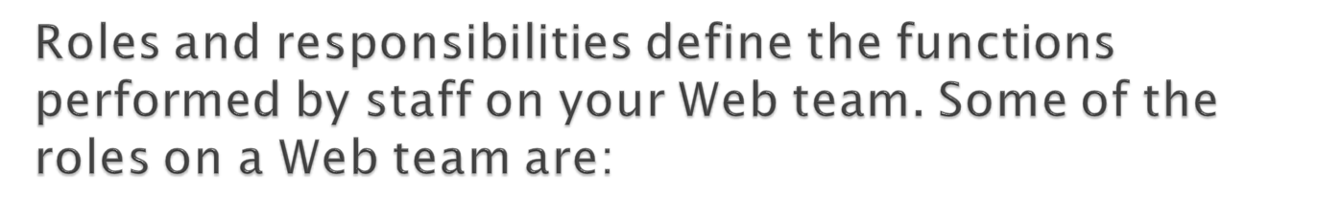
Project manager
Content manager
Editor
Digital/content strategist
Designer
Information architect
Programmer/coder
IT specialist
Analytics specialist
Usability specialist
Subject matter expert/content contributor

Slide 3
Some people on a Web team may have more than one role. For example, a Web manager (who acts as the editor–in–chief for the website) may conduct some usability testing. And a Web editor may produce some Web analytics reports.

Slide 4
A “roles and responsibilities” document explains what each member of your Web team does. The document can be in a simple format, with title, role, and responsibilities. Or it can be more complex, providing fine points about role distinctions and types of responsibilities for specific programs or projects.
Typically, roles and responsibilities are included in the team’s Web governance documents

Slide 5
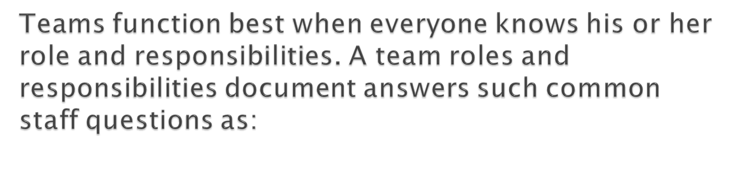
What is expected of me?
Do the people around me understand my function on the team?
Does each member of my team understand their own role and responsibilities?
Do I understand what all my team members do?

Slide 6
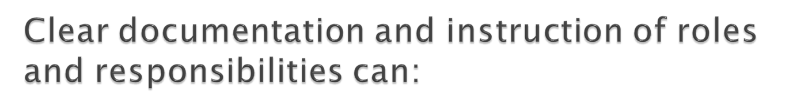
Set clear expectations for team members
Act as a roadmap for staff participation
Reduce redundancies and increase communication and efficiencies
Help avoid misunderstandings and disputes
Facilitate program management
Provide stability through project and staff transitions

Slide 7
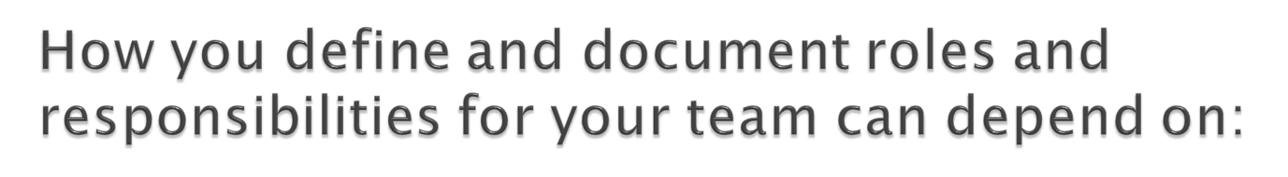
Team size
Number and type of team responsibilities
How the team interacts with other program and project teams
Complexity of team work processes
A planning meeting can help focus and structure the entire team’s thinking. Planning meetings can also be a good method to discover gaps and overlaps in roles and responsibilities.

Slide 8
Position descriptions for Web staff are a good place to help you start documenting the roles and responsibilities on your team, but they should not be your only source of information. Position descriptions show only one dimension: an individual staff member. A position description can’t show how staff interact with others on the team (or on other teams involved in your Web work), or how staff might be involved in program– or project–specific roles, such as contributor, subject matter expert, or project driver.

Slide 9
A responsibility assignment matrix shows relationships and maps out roles and responsibilities. One common type is the RACI model, a simple, two–dimensional matrix that shows level of involvement in work activities. RACI stands for:
Responsible: a person who does work to complete tasks
Accountable: the one person who is accountable for completion of the task
Consult: a person who has input
Inform: a person who needs to know but not necessarily be consulted

Slide 10

Acknowledging every task
Assigning team members appropriately to tasks
Keeping all of your Web activities on course
Tracking staff involvement and tasks outside your Web team
Update your roles and responsibilities documentation regularly; over time, your Web work and the work of team members can change. Keep everyone informed, including your management team.

Slide 11
